Slide 1

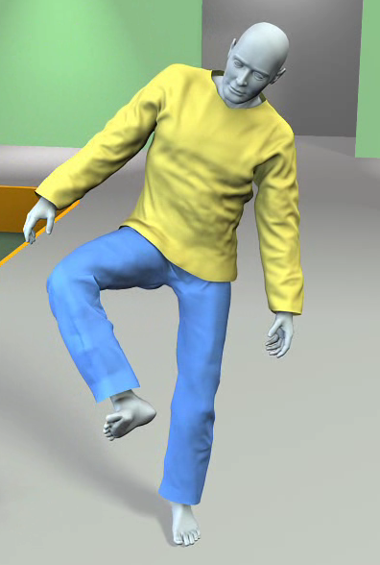
Data-Driven Cloth Animation
Huamin Wang
(whmin@cse.ohio-state.edu)
Ohio State University
Notes:
Shadow under text

Slide 2
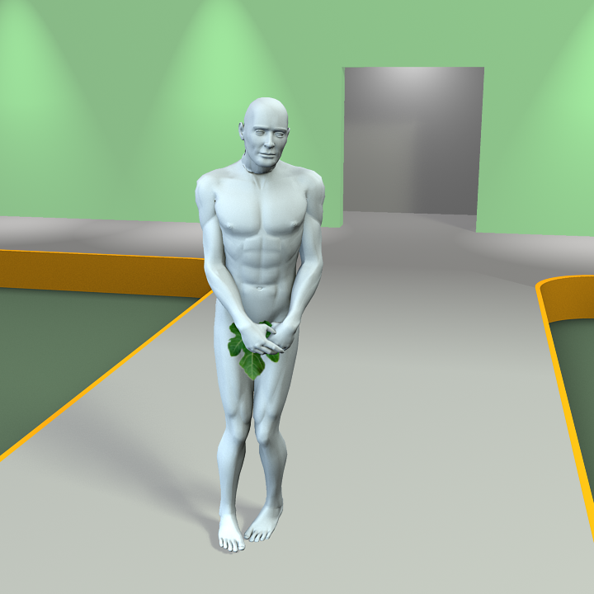
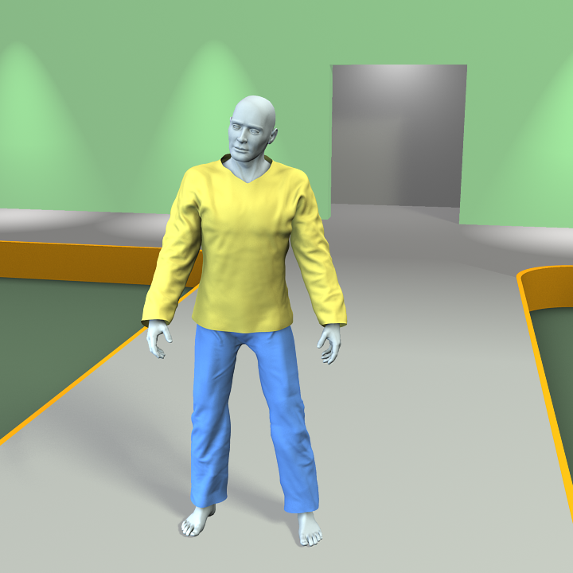
Clothes are important.
Notes:
clothes are important…

Slide 3

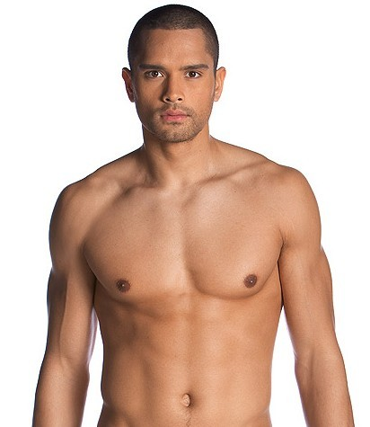
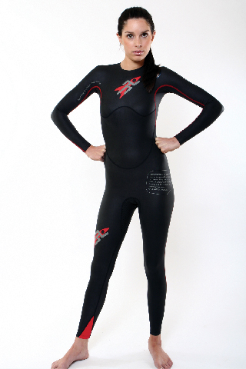
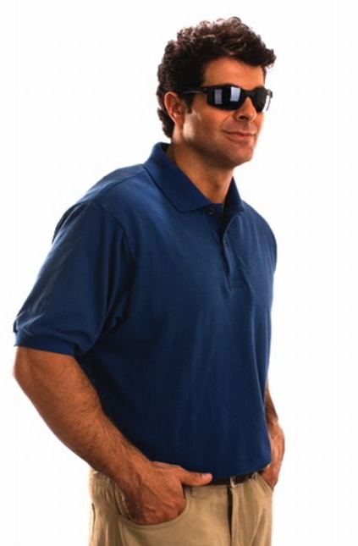
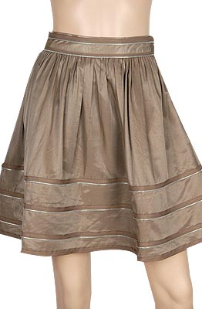
Clothing Classification
Skin
Swimsuit
Shirt
Skirt
Cape
Tight
Loose
Realism?
Efficiency?
Generality?
Data-Driven
Method
Cloth Simulation
For example:
[Allen et al. 2002]
[Mohr and Gleicher 2003]
For example:
[Baraff and Witkin 1998]
[Bridson et al. 2002]
Notes:
Cloth simulation is generally slow even for the cape,
Skin, (data-driven), fast but not applied to cloth.

Slide 4
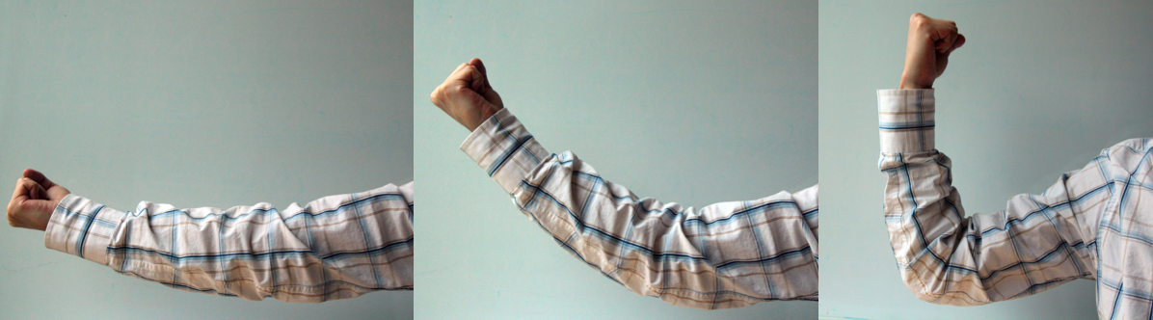
Principle I: Poses decide cloth wrinkles.
Fine Wrinkles
Clothing Animation
Coarse Dynamics
Notes:
One question here is: is it reasonable to simply treat the clothes as a piece of cloth? Probably not, right? In the left picture, the clothes will move together with the character motion, so its shape will be largely determined by the character. But in the right picture there is no character, so basically the cloth can move arbitrarily. We summarize three points that distinguish the clothes from a piece of cloth. First, the pose largely decides the clothing shape. If you can your pose, the clothes will move together with your body. The second interesting observation is that similar wrinkles can be made if you have similar poses. This is because many fabrics have memories in their wrinkles. And finally, we claim that if you only change a single joint each time, only those local wrinkles around the joint can be affected. For example, if you bend your left arm, wrinkles on your right arm barely gets changed.
These points may not always be correct. For example, silk doesn’t have much memory in its wrinkles. Rather, we are considering them as three assumptions we would like to make in formulating our system. And we will demonstrate in our result that these assumptions are fairly reasonable in most cases.

Slide 5
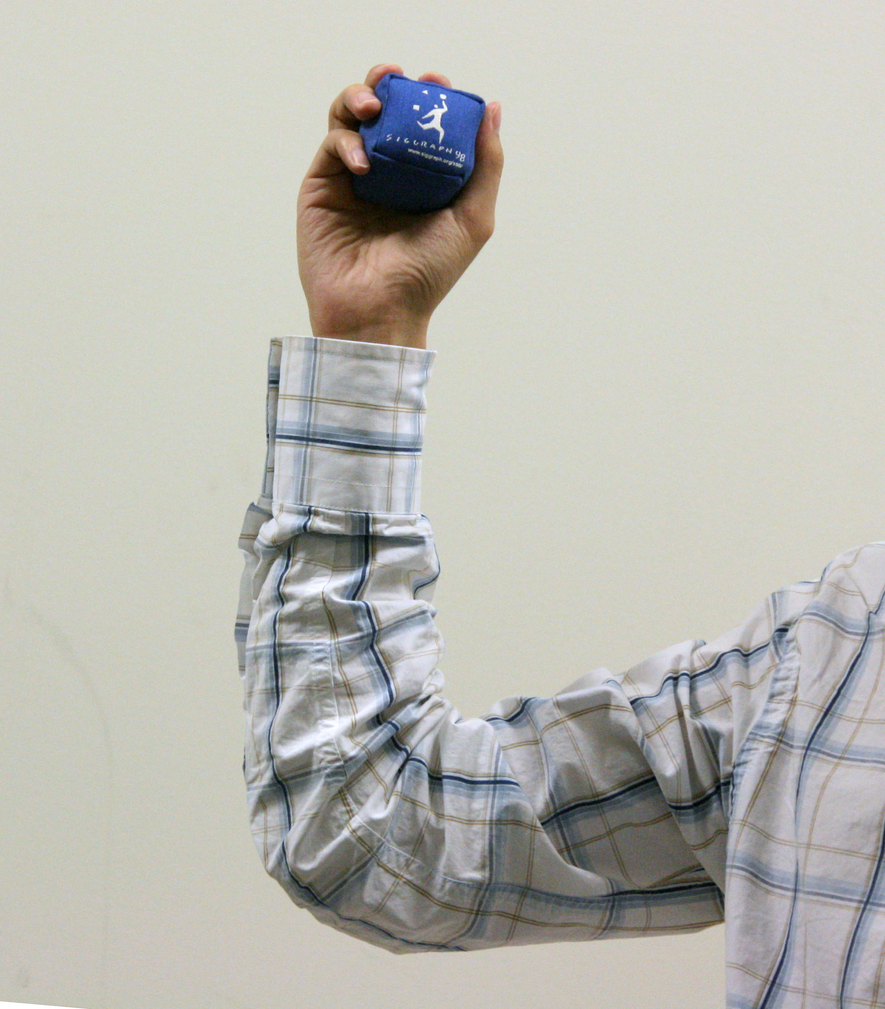
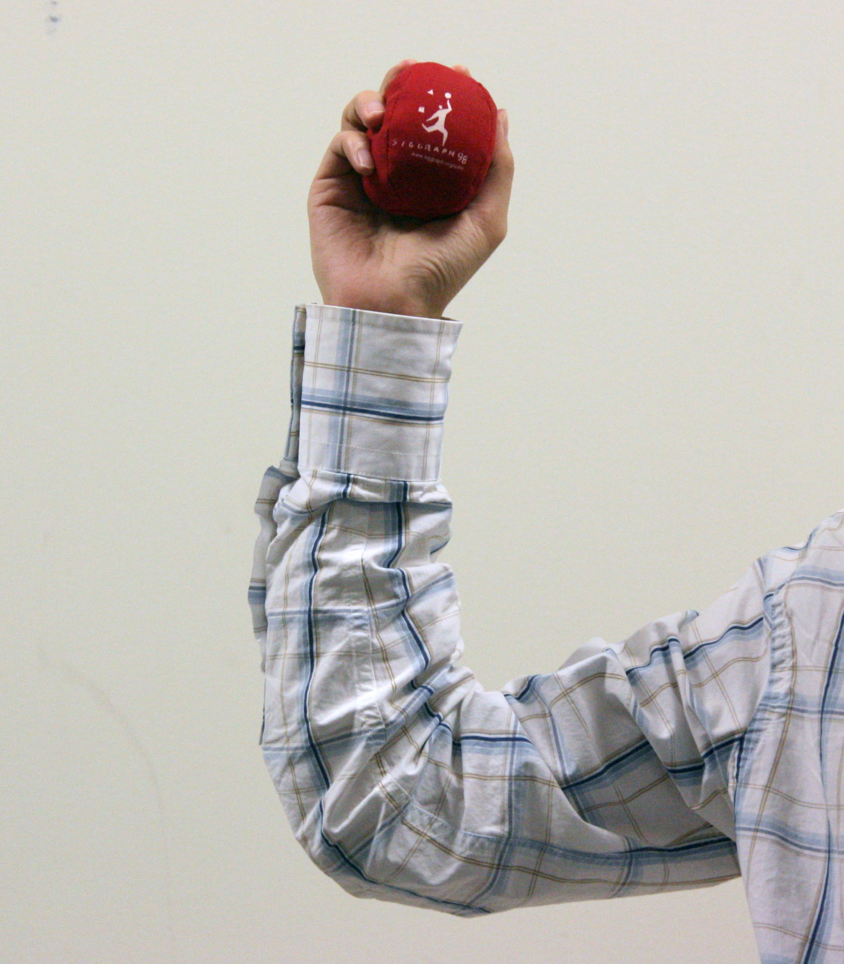
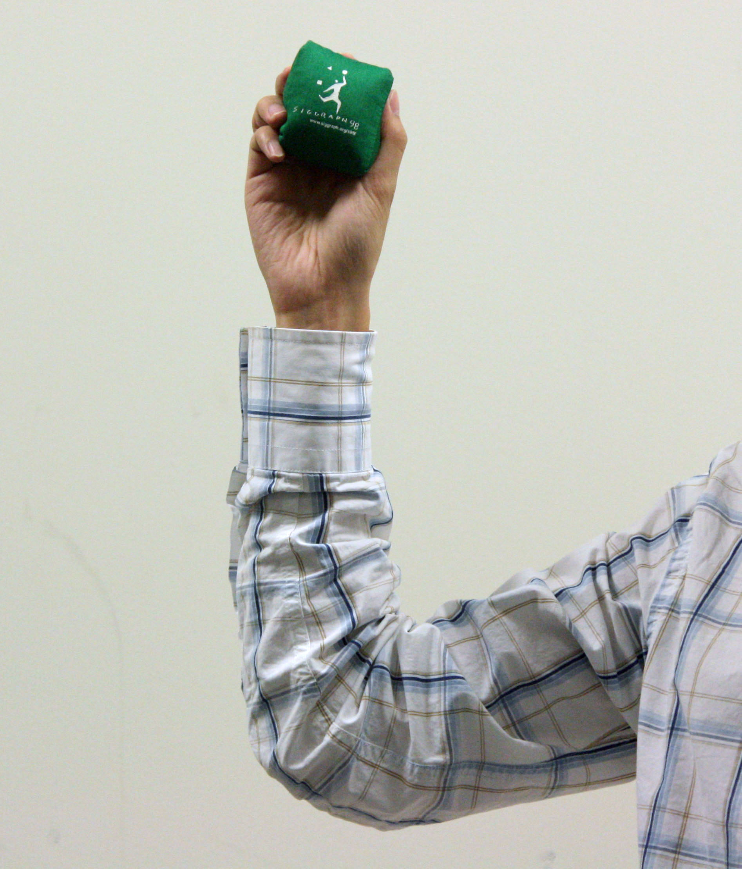
Principle II: Wrinkles are similar.
Wrinkle
Database
Synthesize
Fine Wrinkles
Notes:
Different objects
Wrinkles are nearly identical, and even they are different, people won’t observe the difference visually.

Slide 6
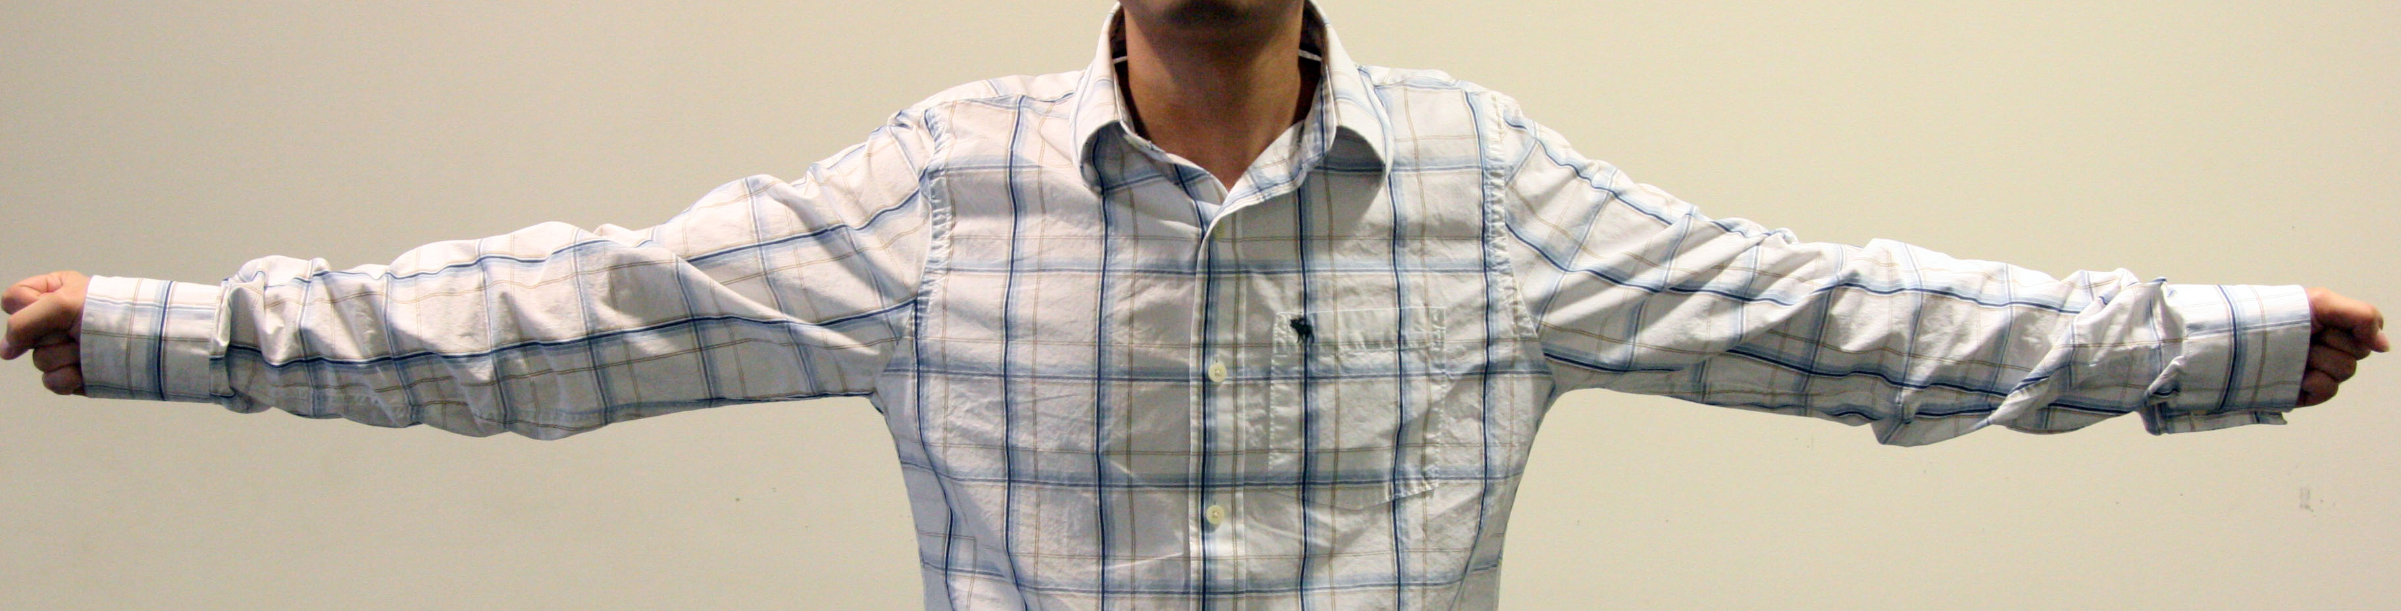
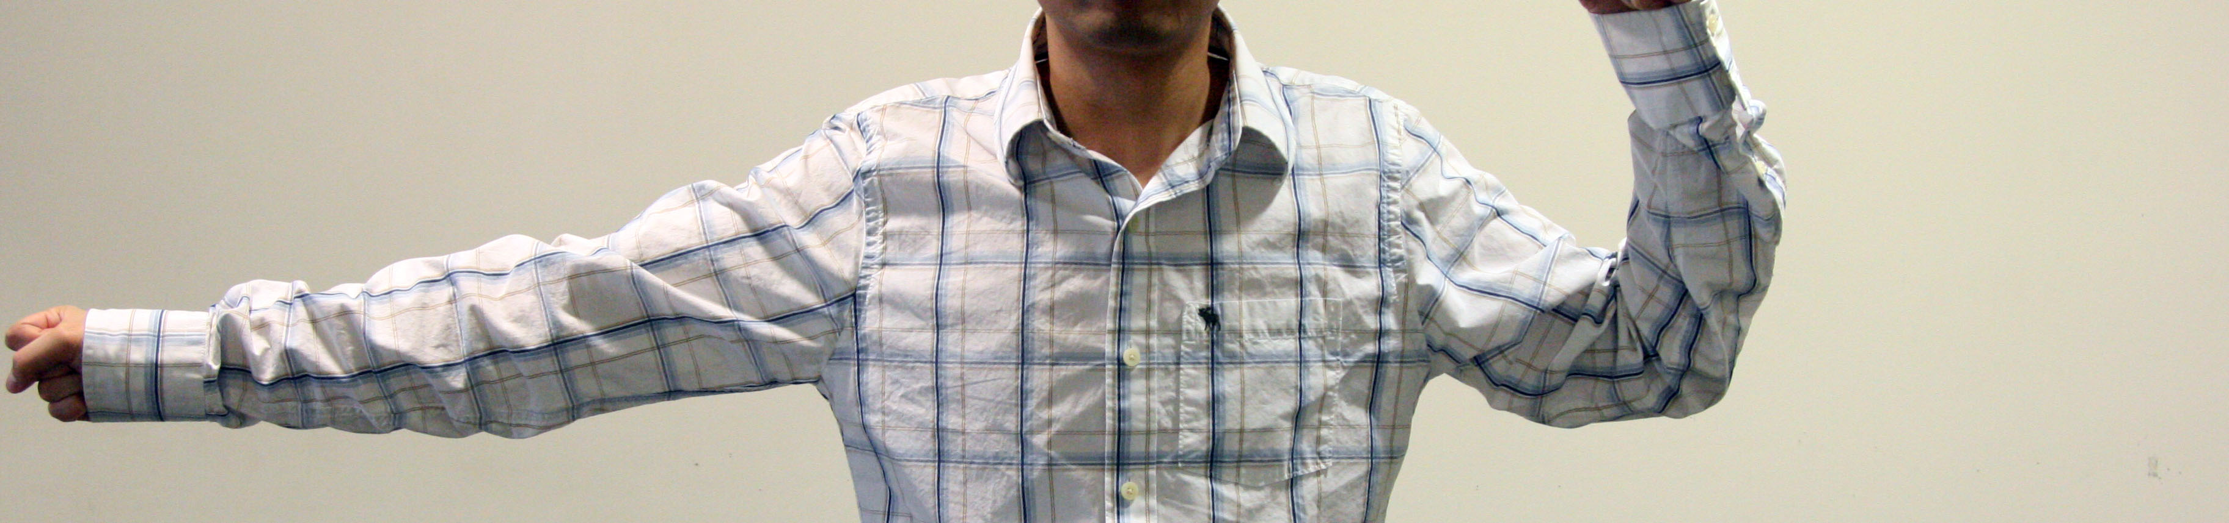
Principle III: Wrinkles are affected locally.
Elbow
Knee
Shoulder
Chest
Hip
Wrinkle Database
Notes:
It reduces the size of the database.

Slide 7
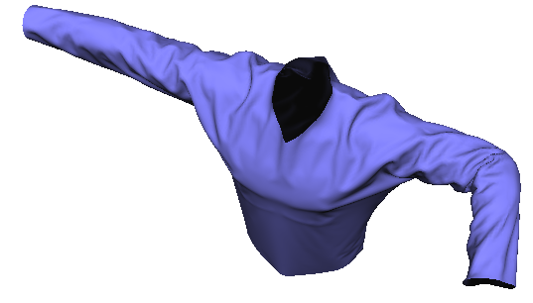
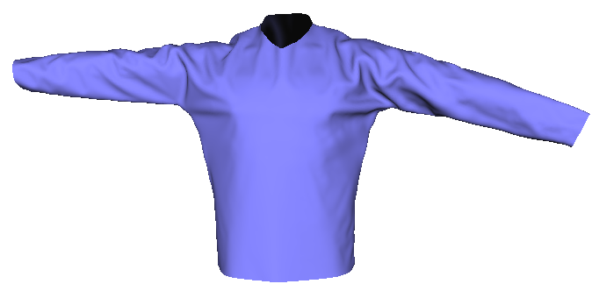
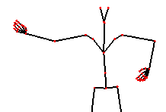
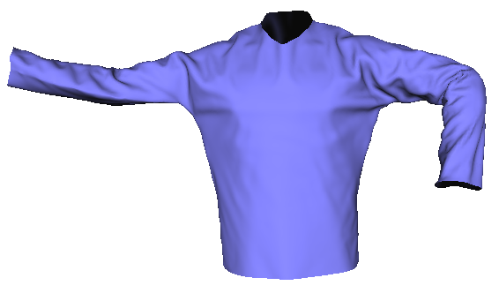
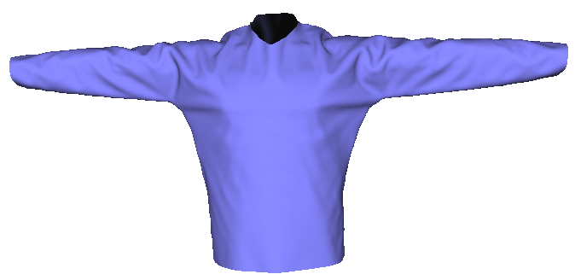
System Pipeline
Elbow
Merge
Synthesize
Shoulder
…
…
Chest
Coarse Simulation
Detail Transfer
Final
Mesh
Notes:
One question here is: is it reasonable to simply treat the clothes as a piece of cloth? Probably not, right? In the left picture, the clothes will move together with the character motion, so its shape will be largely determined by the character. But in the right picture there is no character, so basically the cloth can move arbitrarily. We summarize three points that distinguish the clothes from a piece of cloth. First, the pose largely decides the clothing shape. If you can your pose, the clothes will move together with your body. The second interesting observation is that similar wrinkles can be made if you have similar poses. This is because many fabrics have memories in their wrinkles. And finally, we claim that if you only change a single joint each time, only those local wrinkles around the joint can be affected. For example, if you bend your left arm, wrinkles on your right arm barely gets changed.
These points may not always be correct. For example, silk doesn’t have much memory in its wrinkles. Rather, we are considering them as three assumptions we would like to make in formulating our system. And we will demonstrate in our result that these assumptions are fairly reasonable in most cases.

Slide 8

Notes:
Remove the same database, remove the title

Slide 9
The Database
Elbow
Shoulder
…
Chest
Notes:
One question here is: is it reasonable to simply treat the clothes as a piece of cloth? Probably not, right? In the left picture, the clothes will move together with the character motion, so its shape will be largely determined by the character. But in the right picture there is no character, so basically the cloth can move arbitrarily. We summarize three points that distinguish the clothes from a piece of cloth. First, the pose largely decides the clothing shape. If you can your pose, the clothes will move together with your body. The second interesting observation is that similar wrinkles can be made if you have similar poses. This is because many fabrics have memories in their wrinkles. And finally, we claim that if you only change a single joint each time, only those local wrinkles around the joint can be affected. For example, if you bend your left arm, wrinkles on your right arm barely gets changed.
These points may not always be correct. For example, silk doesn’t have much memory in its wrinkles. Rather, we are considering them as three assumptions we would like to make in formulating our system. And we will demonstrate in our result that these assumptions are fairly reasonable in most cases.

Slide 10
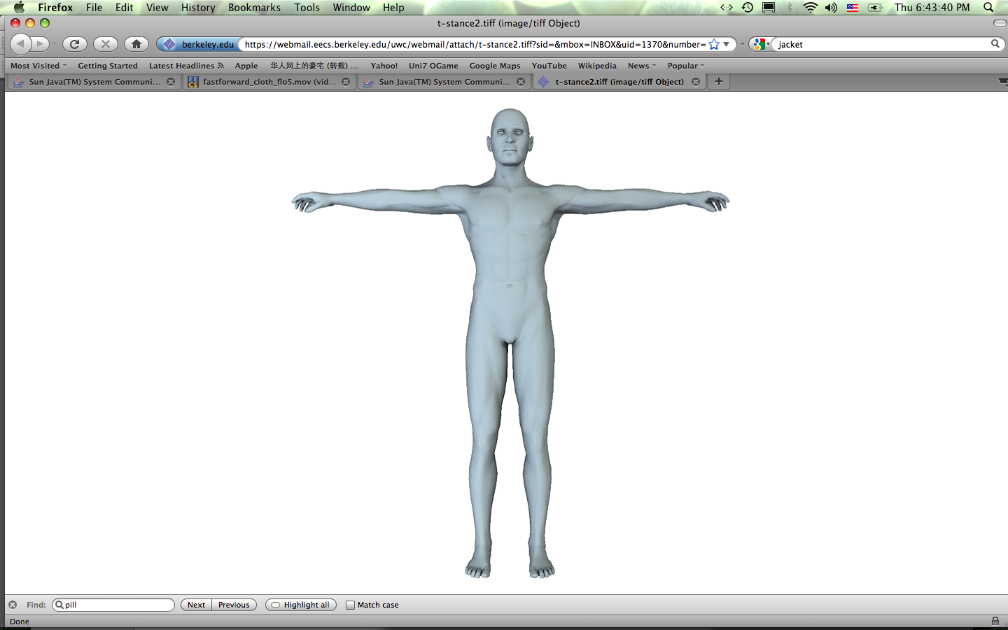
Database Construction
14
126
126
14
# Samples
45
Shirt
Separate Joint (our)
14+126+126+14+45=325
90+90+11+11=202
90
90
Combined Joint (bad)
14×126×126×14×45=140M
90×90×11×11=1M
11
11
# Samples
Pants
Notes:
One question here is: is it reasonable to simply treat the clothes as a piece of cloth? Probably not, right? In the left picture, the clothes will move together with the character motion, so its shape will be largely determined by the character. But in the right picture there is no character, so basically the cloth can move arbitrarily. We summarize three points that distinguish the clothes from a piece of cloth. First, the pose largely decides the clothing shape. If you can your pose, the clothes will move together with your body. The second interesting observation is that similar wrinkles can be made if you have similar poses. This is because many fabrics have memories in their wrinkles. And finally, we claim that if you only change a single joint each time, only those local wrinkles around the joint can be affected. For example, if you bend your left arm, wrinkles on your right arm barely gets changed.
These points may not always be correct. For example, silk doesn’t have much memory in its wrinkles. Rather, we are considering them as three assumptions we would like to make in formulating our system. And we will demonstrate in our result that these assumptions are fairly reasonable in most cases.

Slide 11
Database Construction
Create a body mesh sequence.
Simulate cloth with body motion, using a large damping force.
Pick some frames as joint samples.
Assign each sample with the corresponding cloth mesh.
(48 to 72 hours in total.)
Notes:
Diagram instead

Slide 12
System Pipeline
Elbow
Synthesize
Shoulder
…
…
Chest
Notes:
One question here is: is it reasonable to simply treat the clothes as a piece of cloth? Probably not, right? In the left picture, the clothes will move together with the character motion, so its shape will be largely determined by the character. But in the right picture there is no character, so basically the cloth can move arbitrarily. We summarize three points that distinguish the clothes from a piece of cloth. First, the pose largely decides the clothing shape. If you can your pose, the clothes will move together with your body. The second interesting observation is that similar wrinkles can be made if you have similar poses. This is because many fabrics have memories in their wrinkles. And finally, we claim that if you only change a single joint each time, only those local wrinkles around the joint can be affected. For example, if you bend your left arm, wrinkles on your right arm barely gets changed.
These points may not always be correct. For example, silk doesn’t have much memory in its wrinkles. Rather, we are considering them as three assumptions we would like to make in formulating our system. And we will demonstrate in our result that these assumptions are fairly reasonable in most cases.

Slide 13
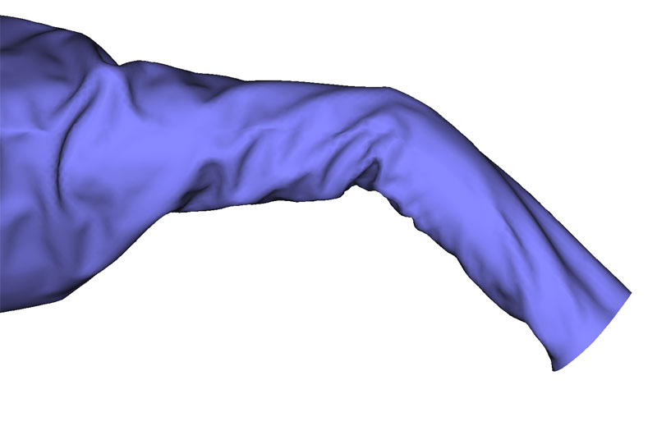
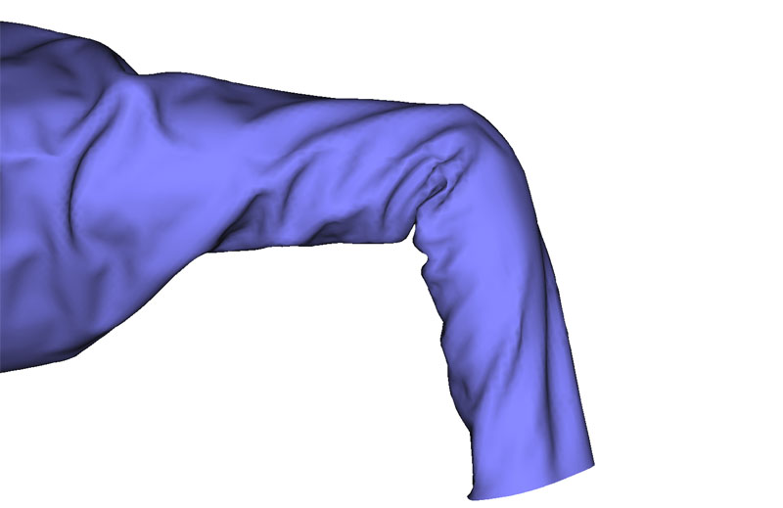
Intra-Joint Interpolation
?
Notes:
Don’t say ‘we tried’. Say ‘previously people used linear interpolation…’

Slide 14
Intra-Joint Interpolation
sθ
d₀
(1-s)θ
d₁
x₀
d_{s}=(1-s)d₀+sd₁
x₁
x_{s}
Notes:
So the intra-joint interpolation is defined this way. We first interpolate the rotation angle. And then we interpolate the vector length.

Slide 15
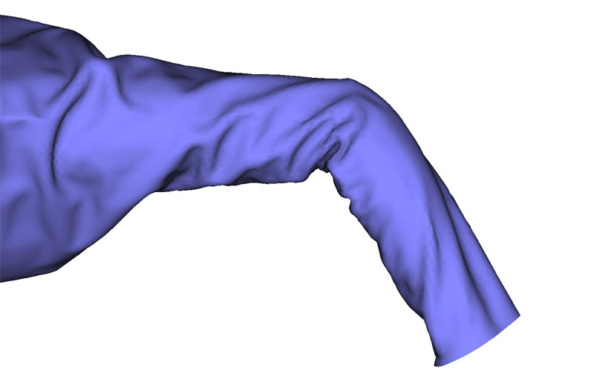
Intra-Joint Interpolation
Mesh Sample 1
Interpolated Result
Mesh Sample 2
Notes:
The result is shown here.

Slide 16
System Pipeline
Elbow
Merge
Synthesize
Shoulder
…
…
Chest
Notes:
One question here is: is it reasonable to simply treat the clothes as a piece of cloth? Probably not, right? In the left picture, the clothes will move together with the character motion, so its shape will be largely determined by the character. But in the right picture there is no character, so basically the cloth can move arbitrarily. We summarize three points that distinguish the clothes from a piece of cloth. First, the pose largely decides the clothing shape. If you can your pose, the clothes will move together with your body. The second interesting observation is that similar wrinkles can be made if you have similar poses. This is because many fabrics have memories in their wrinkles. And finally, we claim that if you only change a single joint each time, only those local wrinkles around the joint can be affected. For example, if you bend your left arm, wrinkles on your right arm barely gets changed.
These points may not always be correct. For example, silk doesn’t have much memory in its wrinkles. Rather, we are considering them as three assumptions we would like to make in formulating our system. And we will demonstrate in our result that these assumptions are fairly reasonable in most cases.

Slide 17
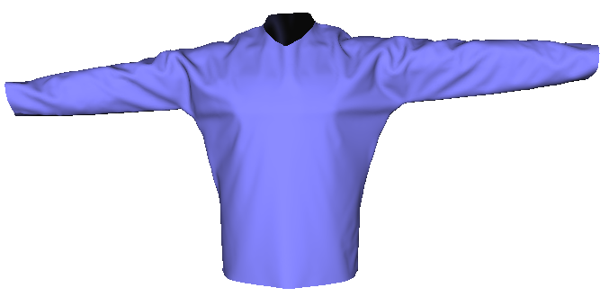
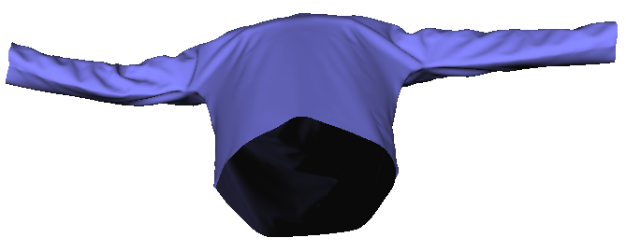
Inter-Joint Merging
i=0
x₀
i=1
x₁
i=2
x
x₂
i=3
x₃
i=4
x₄
Notes:
Suppose we already obtained a set of cloth meshes, each one matches with a specific joint. The next question is how can we combine them together into a final mesh, so that it matches with all the joint configurations. And we found that simple linear interpolation works very well in order to accomplish this task. Let x be a vertex in the mesh, its final position is just the weighted interpolation. Wi is then defined as a weight map for each join mesh.

Slide 18
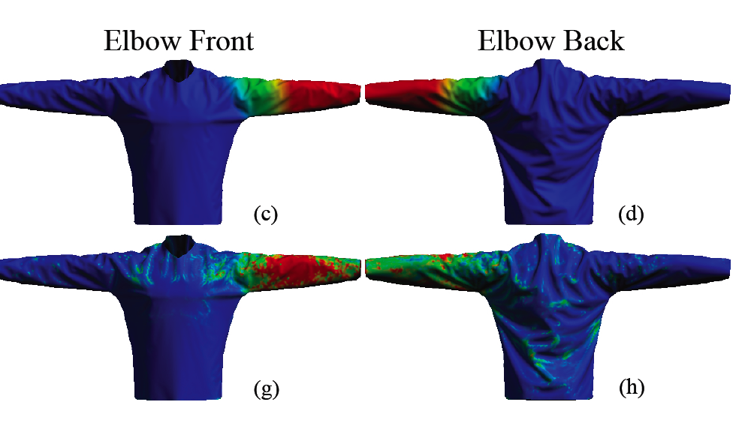
Weight map: Elbow
Elbow Front
Elbow Back
Ours
Analysis
Inner
Elbow
Outer
Elbow
Notes:
The top two pictures here are the weight map we created using a distance function to the elbow joint. The bottom row is an analysis result we obtained to demonstrate how the joint affects the cloth wrinkles. As you can see here, our weight map is quite close to the analysis result. But you can also notice that the elbow joint has different influence on the inner elbow and the outer elbow. This is because when the elbow bends, we have more wrinkles in the inner elbow and the outer elbow.

Slide 19
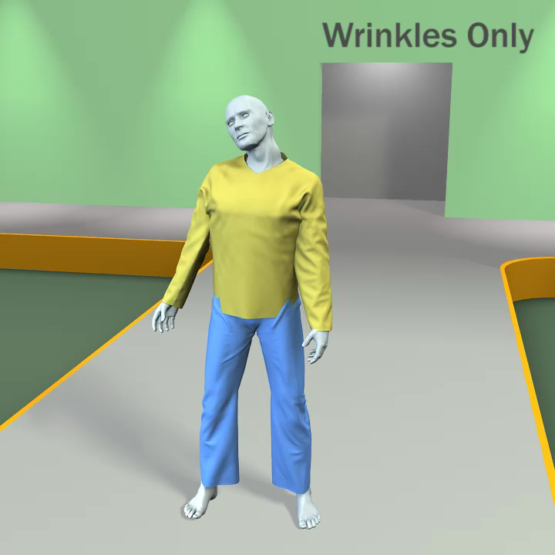
Wrinkle Synthesis Limitations
1. No global dynamics 2. Collisions
Notes:
After doing data-driven synthesis, we get a final cloth mesh created directly from the human pose, as the video here shows. The wrinkle looks nice. But there are still two problems as you can see here. First, there is not dynamics. If you move your body in the same way, the animation will always the same, no matter how fast you move yourself. Second, collisions are not handled. The reason is because, for example, the shirt mesh only considers five upper joints. So if it has collisions with the leg, with the hand, or the external environment, we are not able to tell.

Slide 20
System Pipeline
Elbow
Merge
Synthesize
Shoulder
…
…
Chest
Coarse Simulation
Detail Transfer
Final
Mesh
Notes:
One question here is: is it reasonable to simply treat the clothes as a piece of cloth? Probably not, right? In the left picture, the clothes will move together with the character motion, so its shape will be largely determined by the character. But in the right picture there is no character, so basically the cloth can move arbitrarily. We summarize three points that distinguish the clothes from a piece of cloth. First, the pose largely decides the clothing shape. If you can your pose, the clothes will move together with your body. The second interesting observation is that similar wrinkles can be made if you have similar poses. This is because many fabrics have memories in their wrinkles. And finally, we claim that if you only change a single joint each time, only those local wrinkles around the joint can be affected. For example, if you bend your left arm, wrinkles on your right arm barely gets changed.
These points may not always be correct. For example, silk doesn’t have much memory in its wrinkles. Rather, we are considering them as three assumptions we would like to make in formulating our system. And we will demonstrate in our result that these assumptions are fairly reasonable in most cases.

Slide 21
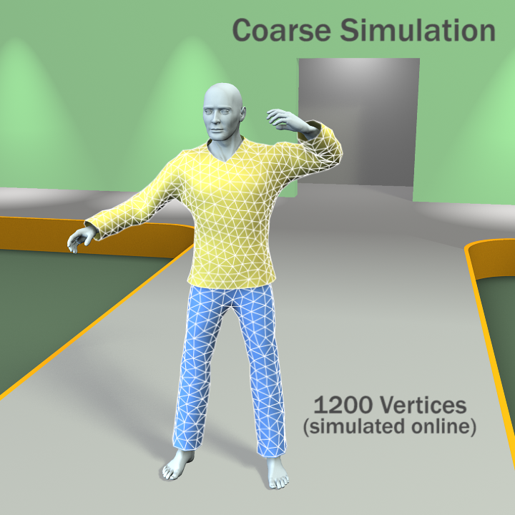
100 frames/second
Notes:
The simulation method doesn’t have those problems. So it also very slow. To make the simulation faster, we can use a simplified mesh. In this case, we can reach 100 fps using 1200 vertices.

Slide 22
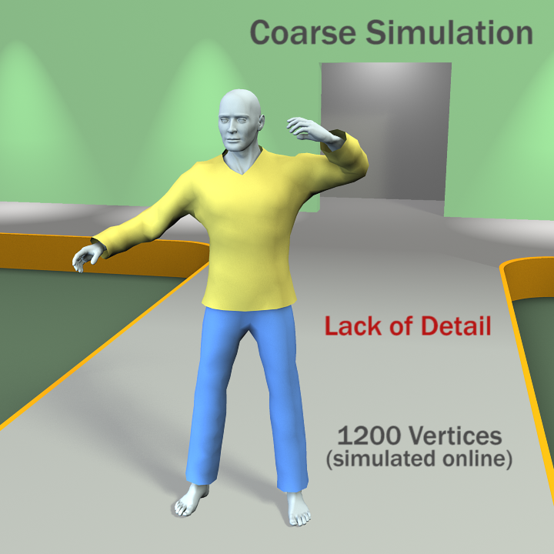
Notes:
The problem though is that we lose all the fine wrinkle details on the cloth and we will get something like this.

Slide 23
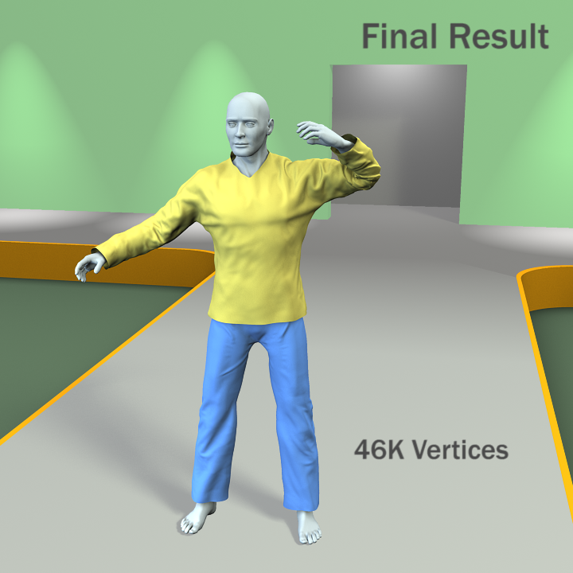
Notes:
So, a natural solution we would like to explore is to put coarse simulation together with data driven synthesis. The question is: how can we do that

Slide 24
Wrinkle Detail Transfer
Transfer
Synthesized Mesh
Final Mesh
Notes:
Suppose this is our synthesized mesh and each blue dot is a vertex in the high resolution mesh. We also have a coarse mesh generated from simulation. Our goal is to transfer all the details in the fine mesh over the coarse mesh. To do that, we first down sample all the fine vertices into a coarse vertex, then we find the offset between the synthesized vertex and the simulation vertex, and apply this offset to all the vertices in the fine mesh. This gives our final mesh with both fine details, and coarse dynamics and collision detections.

Slide 25
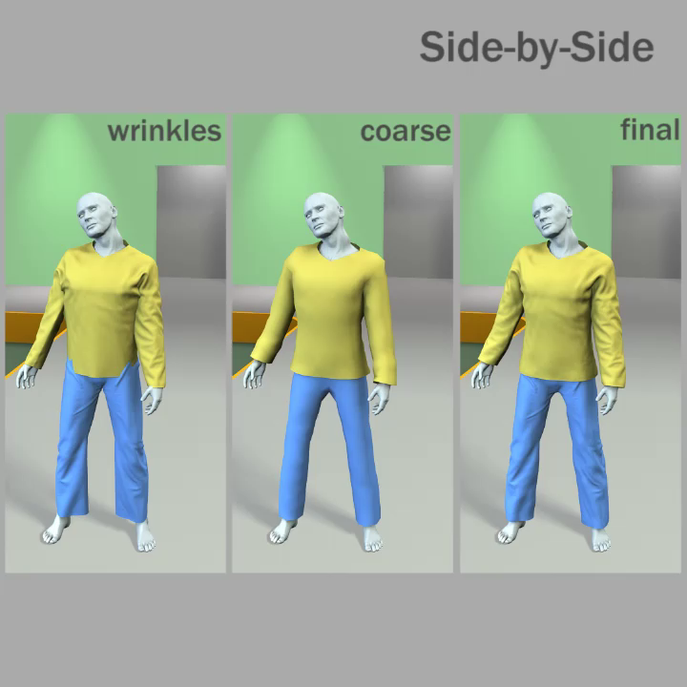
Notes:
This is a side by side comparison of the wrinkle synthesis result, coarse simulation, and our final result.

Slide 26
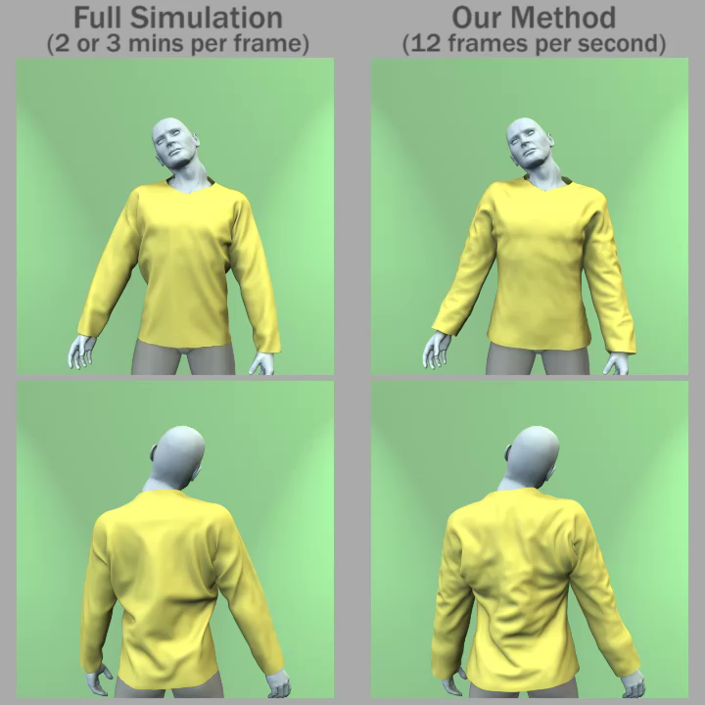
Notes:
This is a side by side comparison of the wrinkle synthesis result, coarse simulation, and our final result.

Slide 27

Notes:
Rendering is done offline even though the animation is done in real-time. Comparison inside.

Slide 28
Summary
Focused on common clothes, has wide applications
Games
Fast preview for offline physical simulation
Combines physics with the database
Greatly reduces the computational cost
Provides realistic results.
Reduces a whole pose space to local pose spaces
Notes:
Heavy precomputation to generate clothing
1. Focused on common clothes
Interactive algorithms, applications such as games, may also for previewing, offline physical simulation
3. Combines physically based simulation with pre-computed database, it greatly reduces the computational cost.
2. Whole pose space -> Local pose space Maybe also relevant to rendering.

